Slide 1
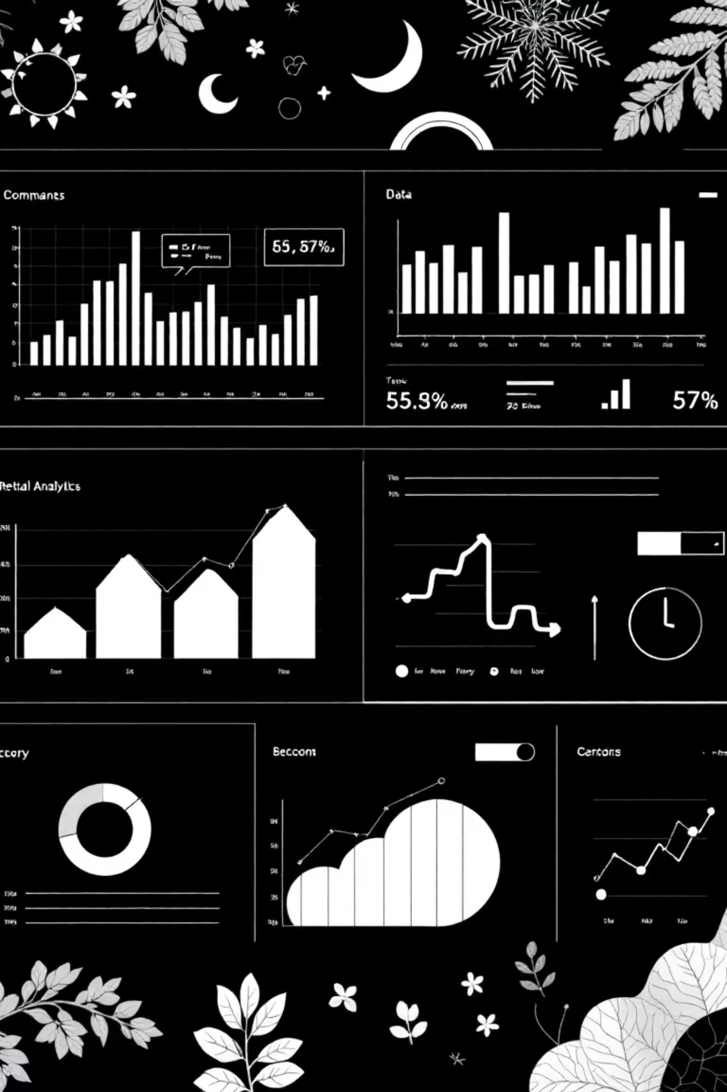
Customer Shopping Behaviour Analysis
Understanding customer behaviour through data-driven insights to improve satisfaction, increase loyalty, and maximize revenue in today's competitive retail environment.

Slide 2
PROJECT OVERVIEW
Data-Driven Retail Intelligence
Dataset Scope
Technology Stack
3,900 customers analyzed across 18 key features including demographics, purchase details, and shopping behaviour patterns.
Comprehensive analysis using industry-standard tools for data processing and visualization.
MS Excel for initial data handling
Customer demographics and subscription status
Python (Pandas, NumPy) for analysis
Purchase details and product categories
MySQL for database management
Shopping behaviour and review ratings
Power BI for visual insights

Slide 3






PYTHON ANALYSIS
Data Processing Pipeline
Data Loading
Imported Excel dataset into Python using Pandas for comprehensive analysis.
Exploration
Used df.info() and .describe() to understand structure and summary statistics.
Data Cleaning
Imputed 37 missing Review Rating values using median by product category.
Integration
Connected to PostgreSQL and loaded cleaned data for SQL analysis.

Slide 4

Customer Demographics Snapshot
44
$60
3.75
25
Average Age
Avg Purchase
Avg Rating
Previous Buys
Median customer age across all segments
Average purchase amount per transaction
Overall customer satisfaction score
Average number of prior purchases

Slide 5
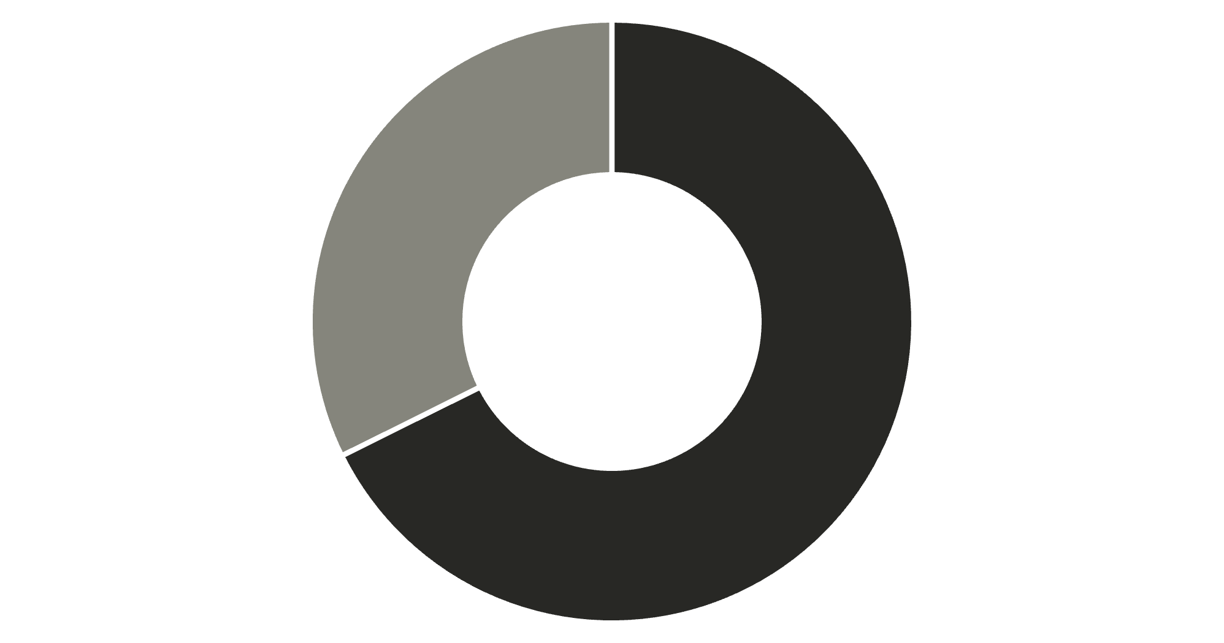
REVENUE INSIGHTS
Gender Revenue Analysis
Key Finding
Male customers generated $157,890 in total revenue compared to $75,191 from female customers, representing a significant revenue gap.
This insight suggests opportunities for targeted marketing strategies to balance customer engagement across gender segments.
Male
Female

Slide 6
Top-Rated Products
Products with the highest average customer review ratings demonstrate quality and customer satisfaction.
1
2
3
Gloves
Sandals
Boots
Average rating: 3.86
Average rating: 3.84
Average rating: 3.82
4
5
Hat
Skirt
Average rating: 3.80
Average rating: 3.78

Slide 7



CUSTOMER SEGMENTS
Loyalty Classification
New
1
83 customers
Returning
2
701 customers
Loyal
3
3,116 customers
Customers segmented based on purchase history: New (1 purchase), Returning (2-10 purchases), and Loyal (10+ purchases). The majority are loyal customers, indicating strong retention.

Slide 8


Subscription & Spending Patterns
Subscription Status
Average Spend Comparison
Subscribed: $59.49
Non-subscribed: $59.87
27%
Surprisingly, non-subscribers spend slightly more on average. Among repeat buyers (5+ purchases), 958 are subscribed vs. 2,518 non-subscribed.
Subscribed customers (1,053)
73%
Non-subscribed (2,847)

Slide 9
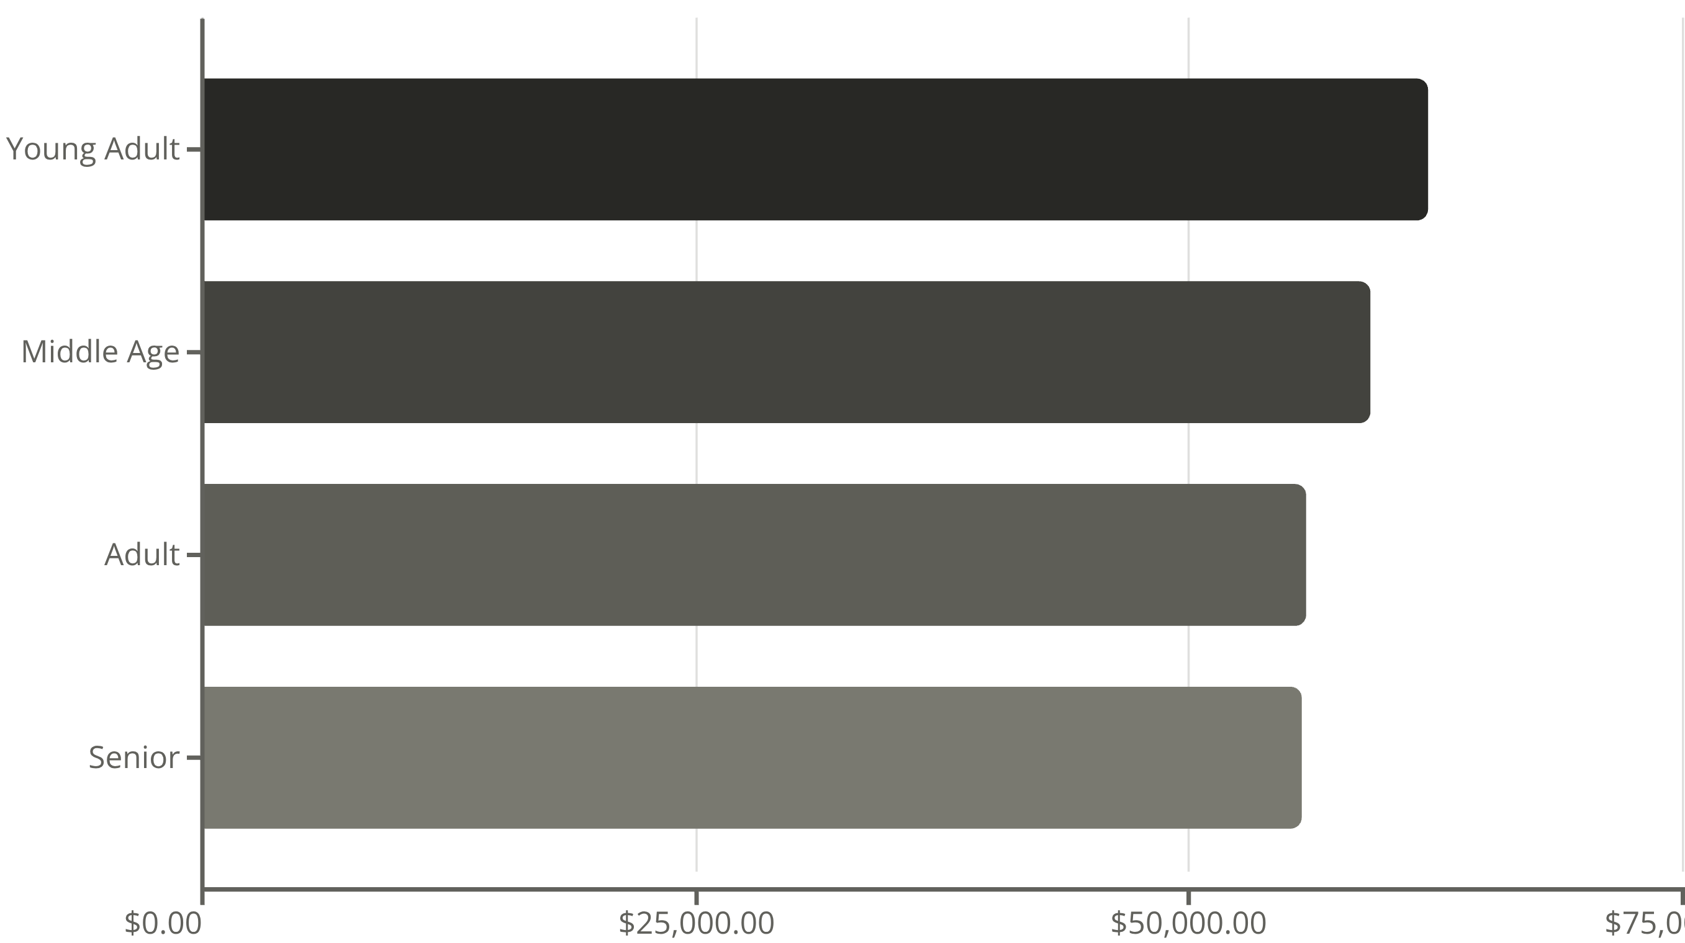
Revenue by Age Group
Young adults generate the highest revenue at $62,143, followed closely by middle-aged customers. Revenue distribution is relatively balanced across age groups, suggesting broad market appeal.

Slide 10

STRATEGIC INSIGHTS
Business Recommendations
Boost Subscriptions
Promote exclusive benefits to convert the 73% non-subscribed customer base into loyal subscribers.
Loyalty Programs
Reward repeat buyers to accelerate their journey from "Returning" to "Loyal" segment status.
Discount Strategy
Balance promotional sales boosts with margin control to optimize profitability across product lines.
Targeted Marketing
Focus campaigns on high-revenue age groups and highlight top-rated products like gloves and sandals.

